Slide 1
WFIRST CGI Detector Radiation Environment
2017–01-31
Michael Cherng & Patrick Morrissey
Jet Propulsion Laboratory
©California Institute of Technology, Government sponsorship acknowledged

Slide 2
Outline
L2 Radiation Environment
6 year mission in an L2 orbit
Solar flare protons
Galactic Cosmic Rays (GCR)
Radiation Transport Calculation
2

Slide 3
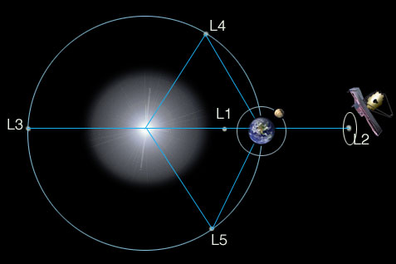
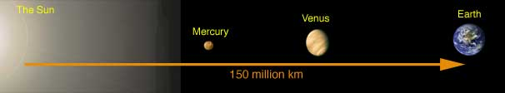
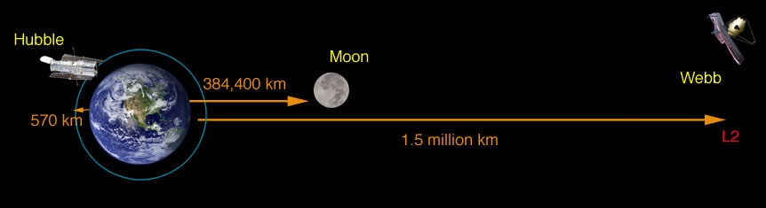
L2 Orbit
The relative location of the L2 point with respect to the Sun and Earth
Figure 2. Sun, Earth, and L2 Point

Slide 4
L2 Radiation Environment
The dominant radiation source is solar protons from Solar Energetic Particle Events (Solar Flares)
Protons fluence from Galactic Cosmic Rays (GCRs) is 3 order of magnitudes lower than solar protons
4

Slide 5
LEO vs L2
HST Orbit
L2 Orbit@235Re
2
4
6
HST and CGI are in very different environments
Lunar Orbit@60Re
 | E>10MeV Trapped and Solar Protons | E>10MeV GCR
 | 7 year fluence (p-cm⁻²)
HST | 1.13e11 | 2.8e8
L2 | 6.48e11 | 9.8e8

Slide 6
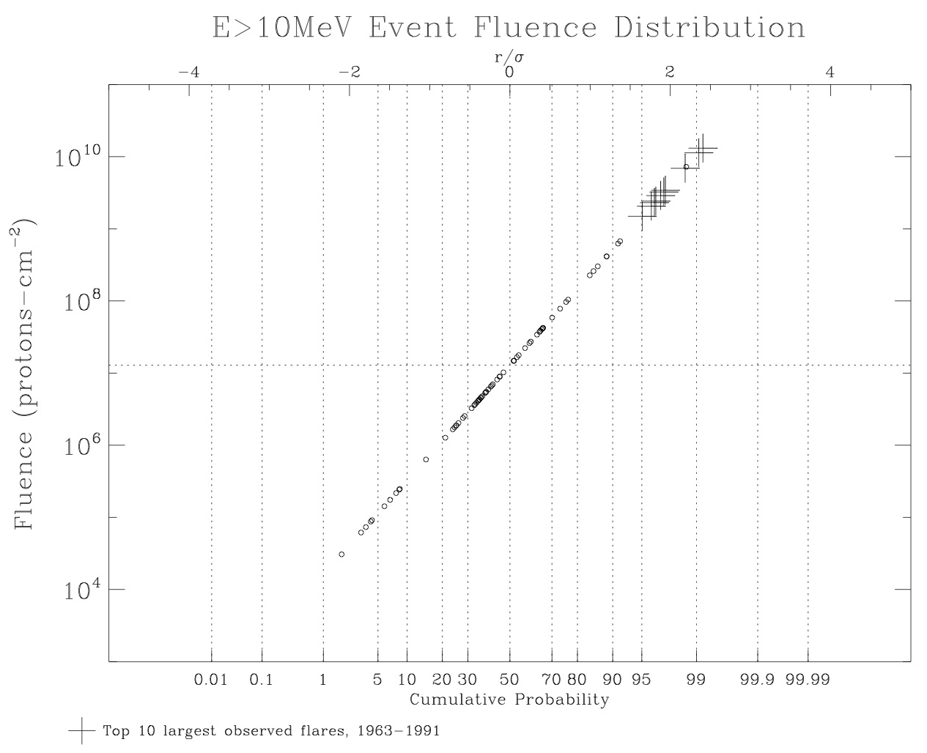
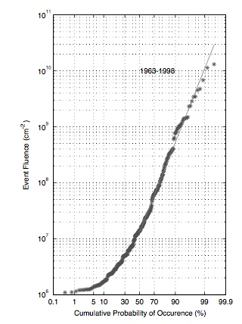
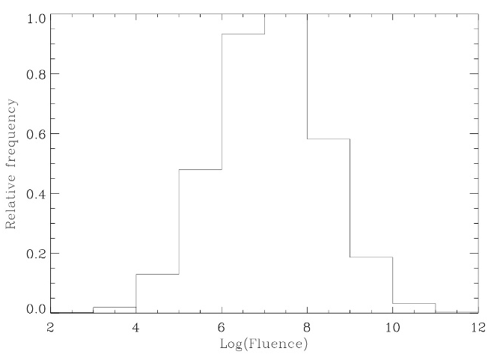
10 Largest
Observed Flares
Feynman 2002
(35 years of data)
Log-normal Model
Distribution
~68 flares in 7 years

Slide 7
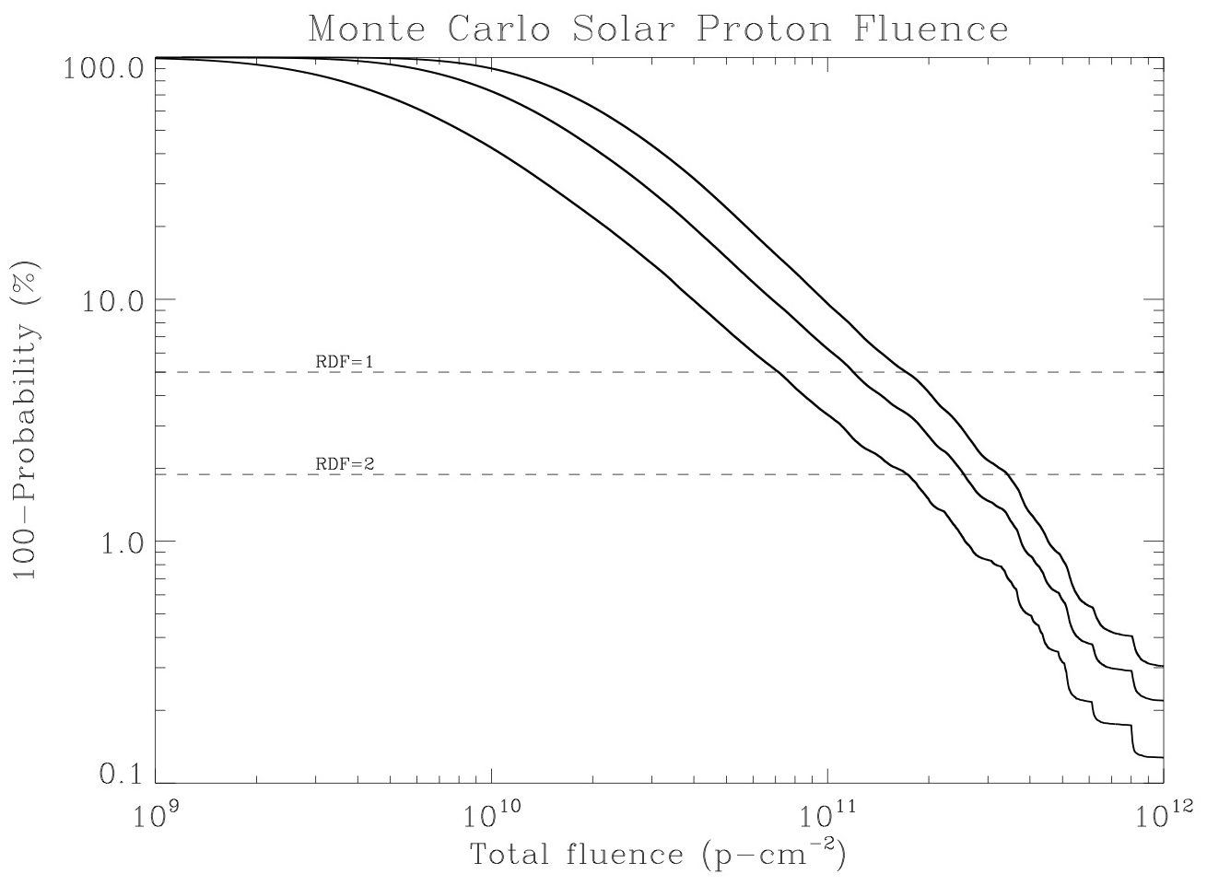
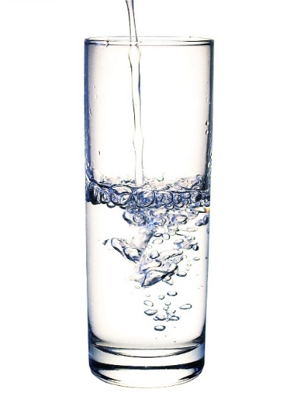
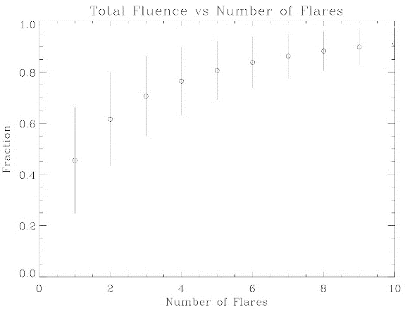
Half empty or half full?
How conservative is the test level?
7 years
5
3 years
95% confidence
98% confidence
Most L2 CCD damage will likely result from just 1-5 flares in a solar cycle, and these flares may occur any time during the 7-year active period.

Slide 8
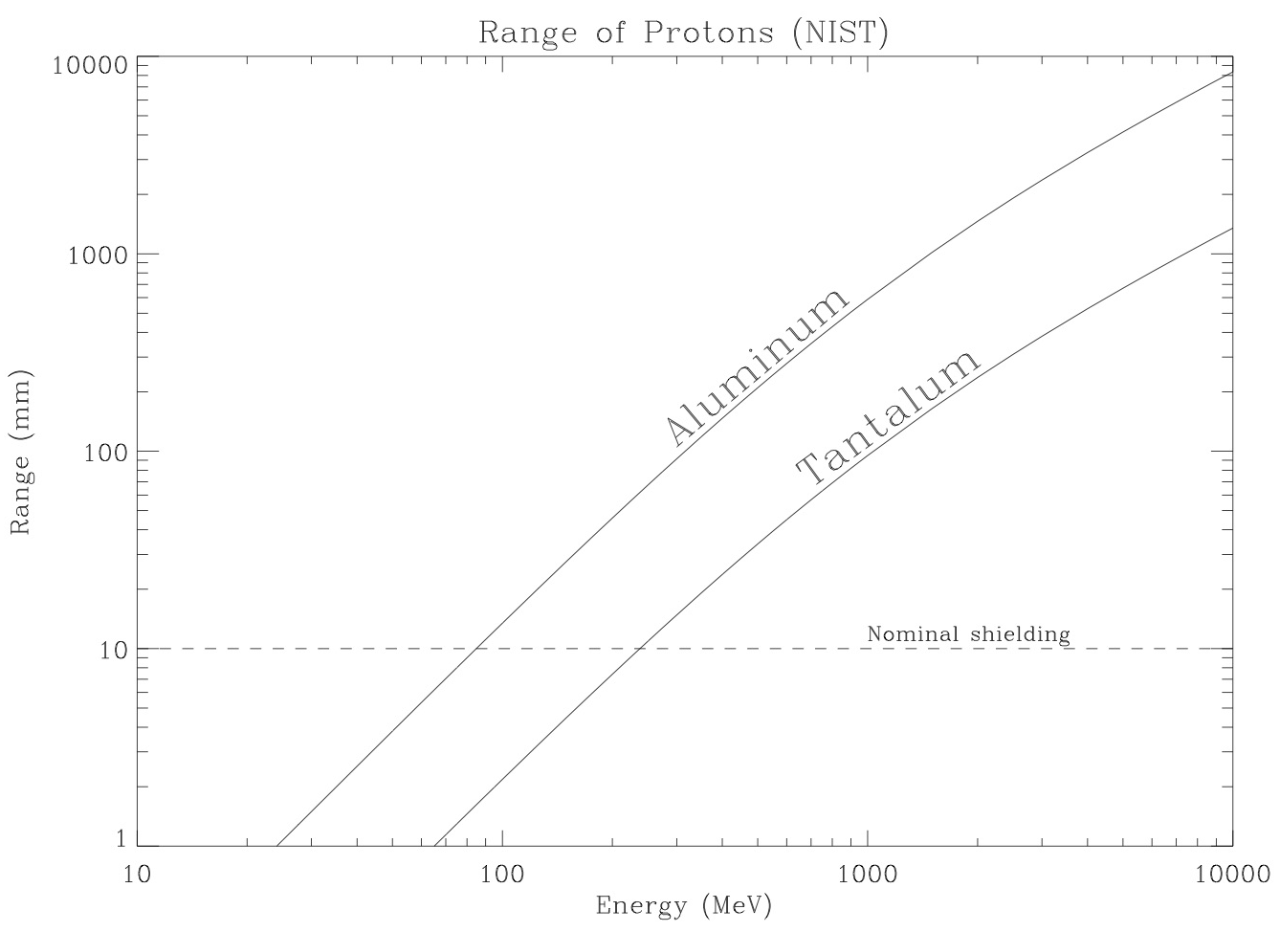
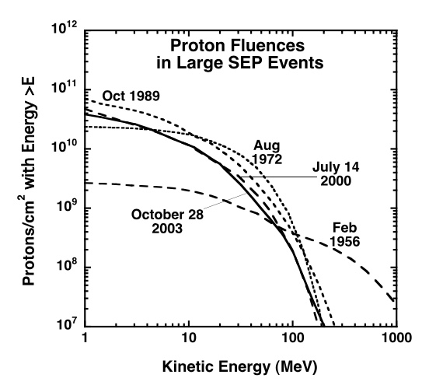
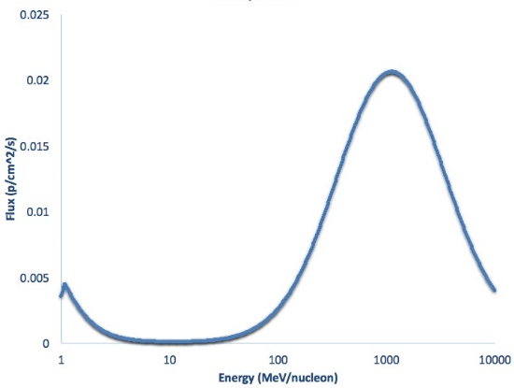
Range of Protons in Matter
Mewaldt 2005
Solar
GCR
Nominal Shielding

Slide 9
Radiation Level Calculation
Estimate the L2 environment using validated code
JPL 91 Solar Proton Model
Specify total fluence spectrum over lifetime [particles/cm²]
Simulate radiation exposure of detector using radiation transport code
Displacement Damage Dose (DDD)
Total Ionizing Dose (TID)
9

Slide 10
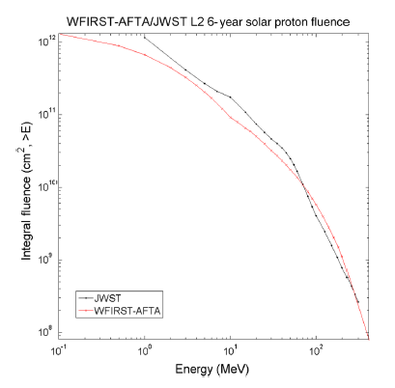
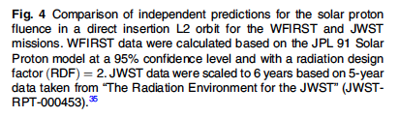
Radiation Code Comparison
Solar Proton Code Cross Check
Predictions of solar protons at L2 for WFIRST and JWST were compared
WFIRST (JPL model at 6 yrs)
JWST (GSFC model scaled to 6 yrs)
Independent models
10

Slide 11
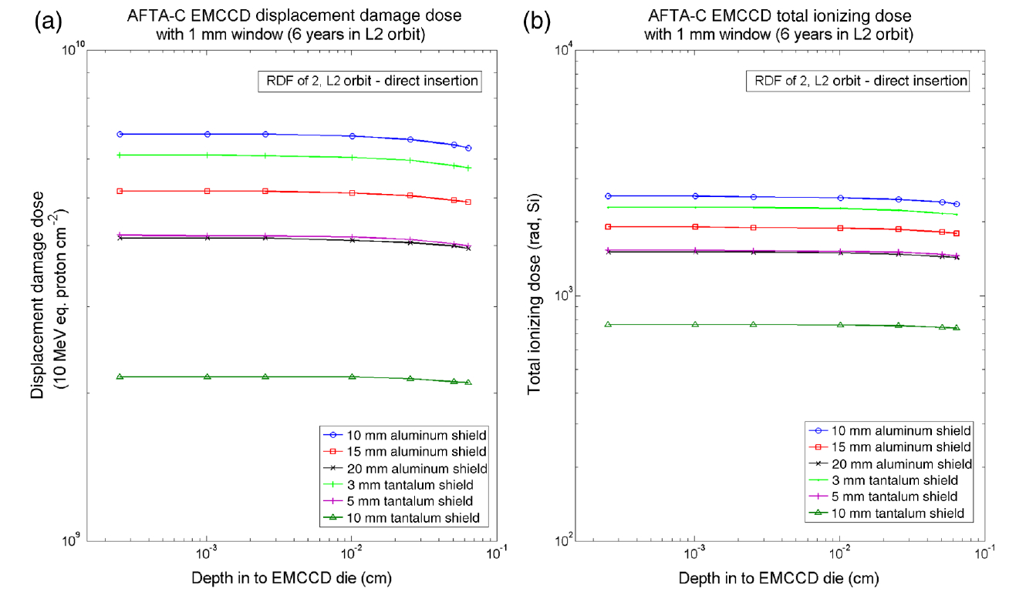

Summary of Radiation Analysis
Radiation transport code NOVICE used to predict DDD and TID in L2
Direct insertion orbit, i.e. trajectory through Earth’s trapped-particle rad belts is inconsequential
Soar proton model run at 95% confidence level
Code was run for a range of camera shielding materials/thicknesses to in form choice of maximum test exposure
Performance after mission life exposure was used to optimize shielding material/thickness
Code predicted cumulative TID of only 1 krad with 1 mm glass window
=> DDD is the major hazard
Harding & Demers, et al. (2016)
Aperture for image light
Phase II (Cryo)
Phase I (RT)
Camera package
Fold Mirror
11

Slide 12
Limits of Shielding
End of Life (EOL) DDD Exposure [10 MeV protons/cm²]
Test at RDF = 2 per JPL Flight Practices
Two devices irradiated to this fluence
Data from analysis by Michael Cherng JPL Internal Memo 5132-15-015, 18 March 2015 & recent results July 2016
12

